Slide 1
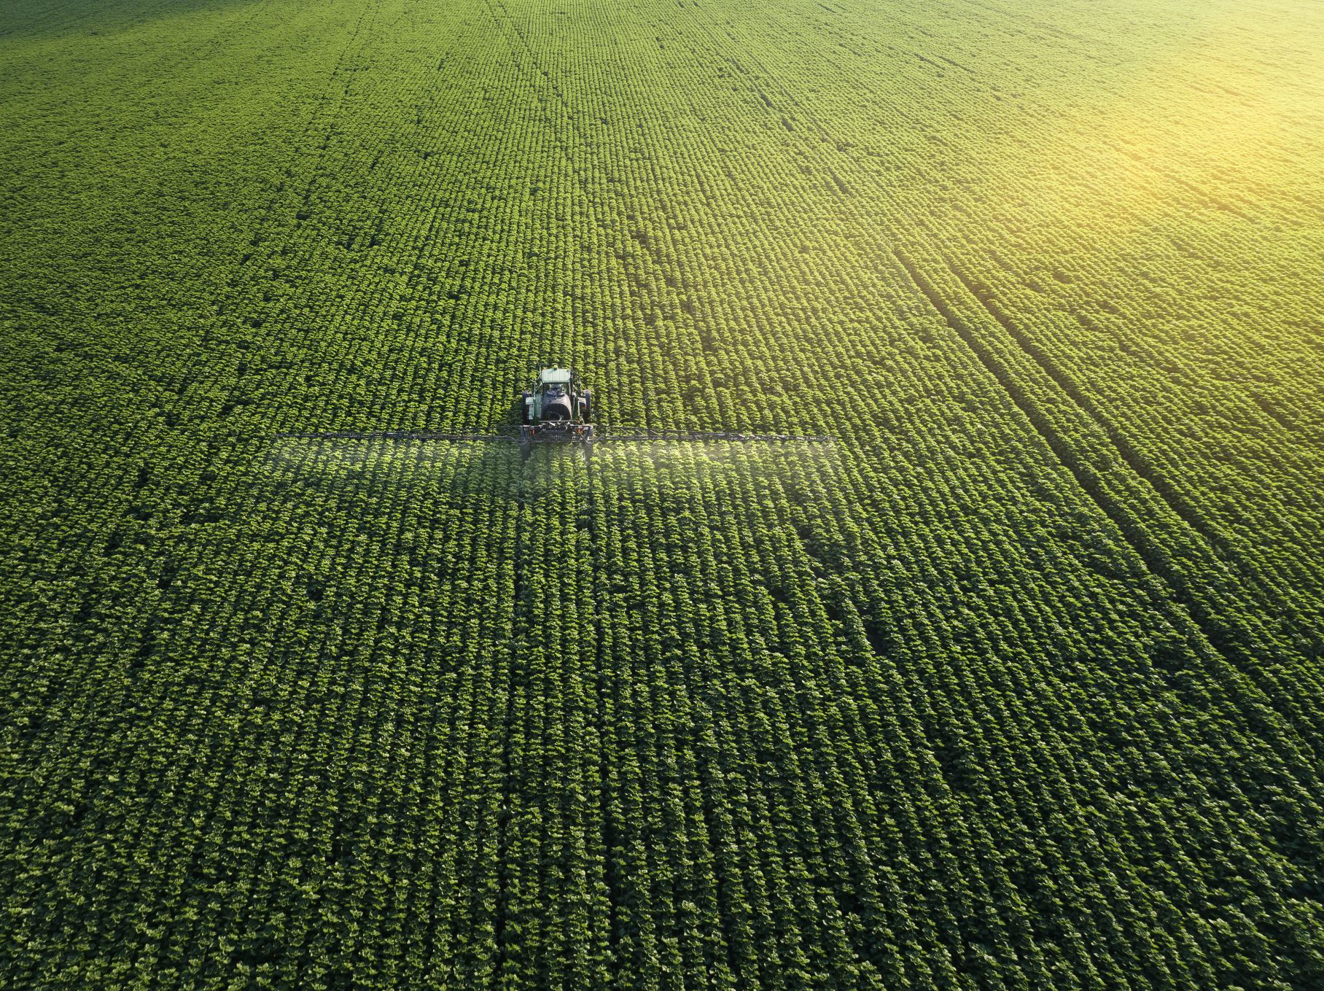
FARM MATE Farmers Connecting to Consumers
A Direct Digital Platform for Agricultural Commerce

Slide 2
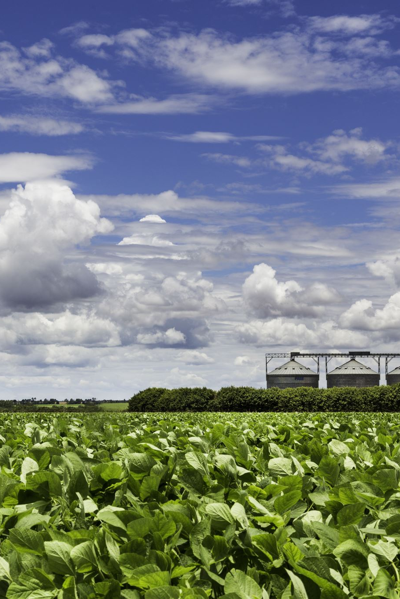
Introduction
Agriculture is vital but supply chains are inefficient. This platform connects farmers directly to consumers.

Slide 3

Project Aim
• Bridge farmers and consumers • Eliminate middlemen • Ensure fair pricing and fresh products

Slide 4
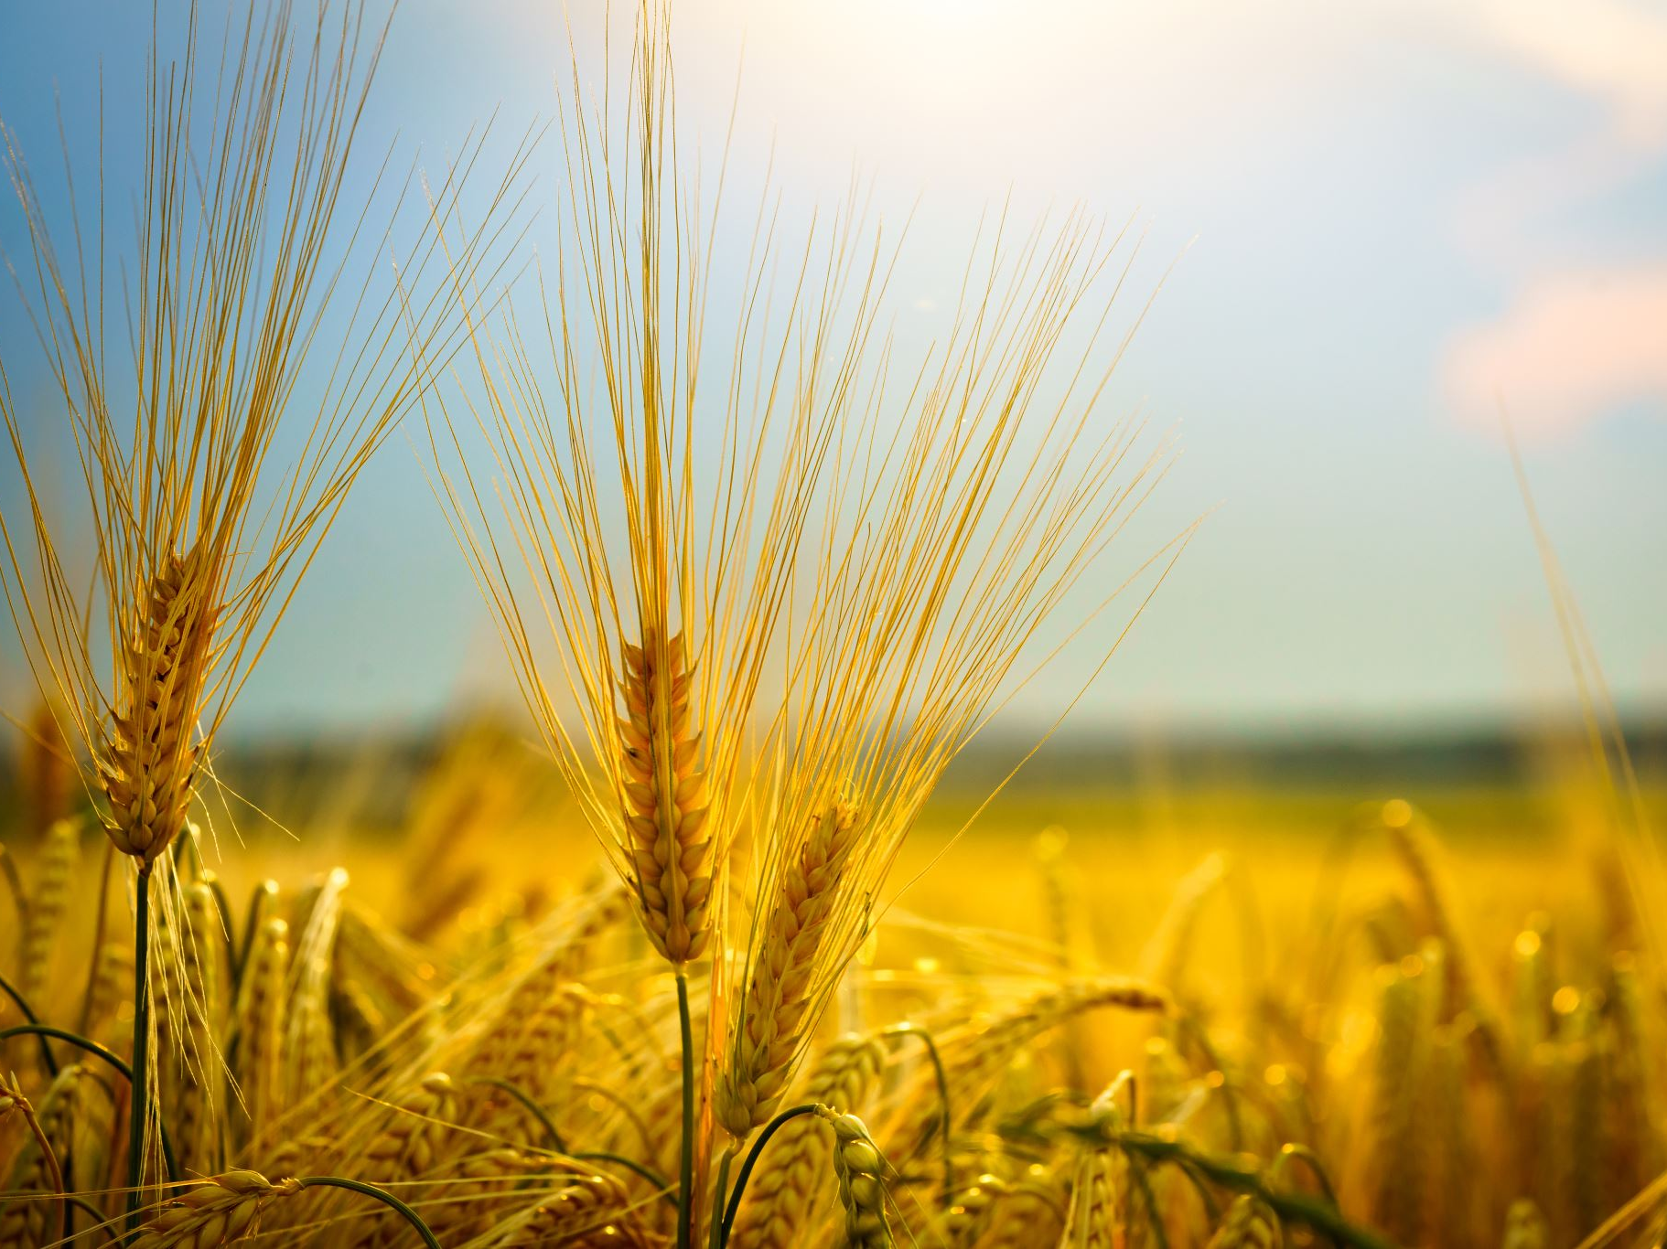
Project Goals
• Empower farmers • Provide fresh, affordable produce to consumers • Promote local agriculture

Slide 5
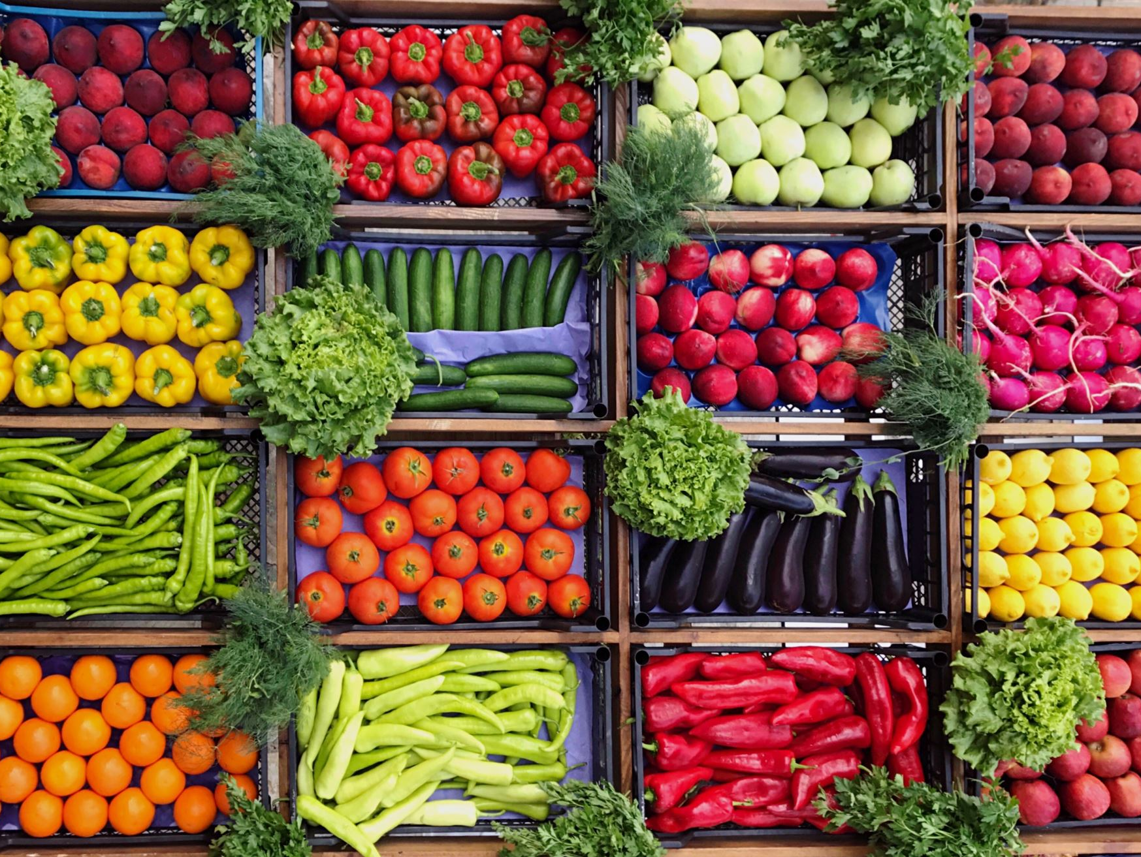
Problem Statement
• Farmers earn less • Consumers pay more • Lack of transparency

Slide 6

Proposed Solution
• Digital app for direct interaction • Farmer and consumer portals • Real-time management

Slide 7
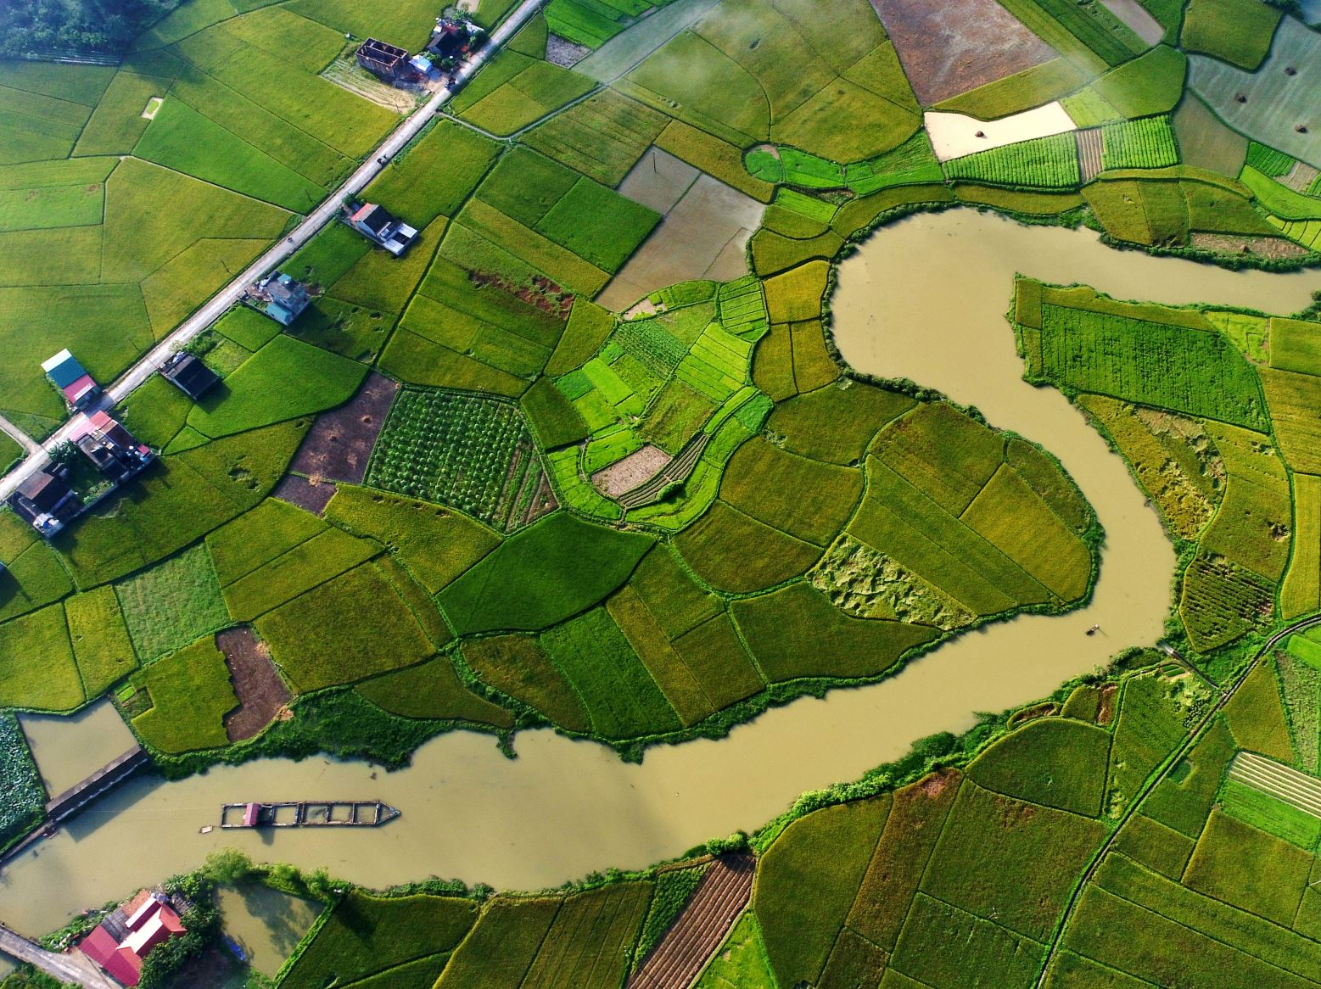
System Architecture
Flow: Farmer uploads ➔ Consumer browses ➔ Places Order ➔ Payment ➔ Delivery

Slide 8
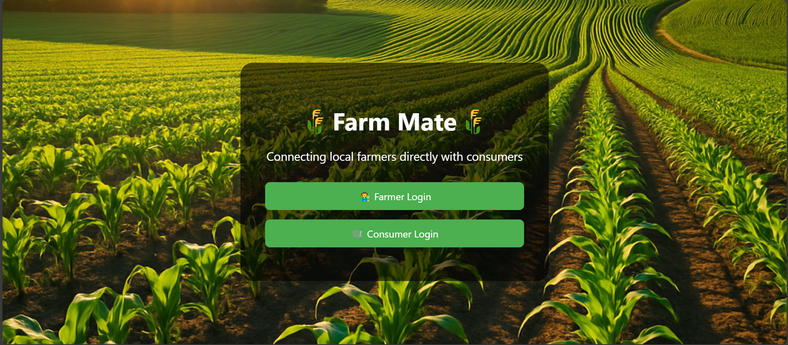
Index Overview
• Farmer Module • Consumer Module

Slide 9
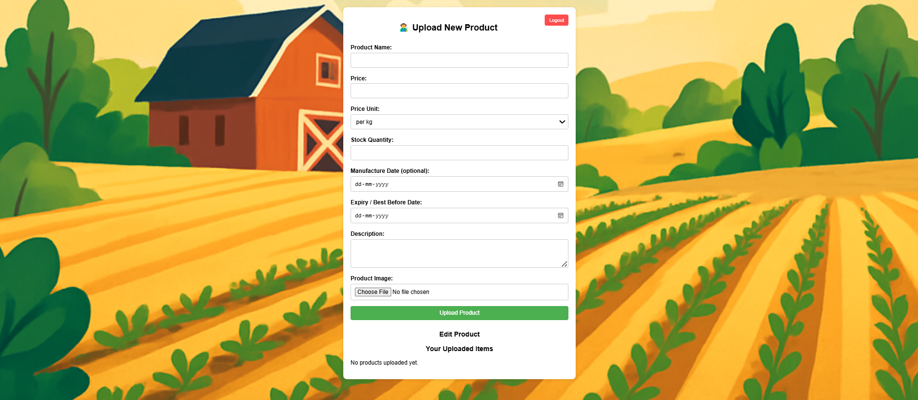
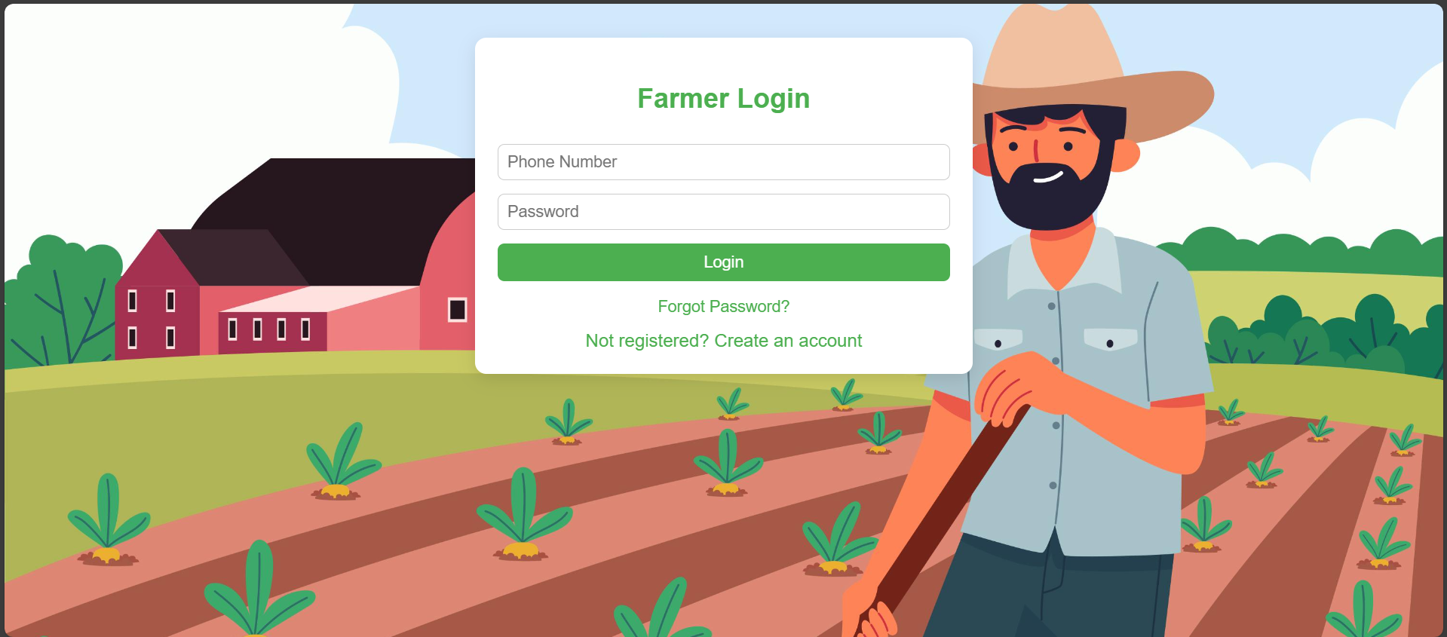
Farmer Module
• Farmer signup/login • Manage products • View orders

Slide 10
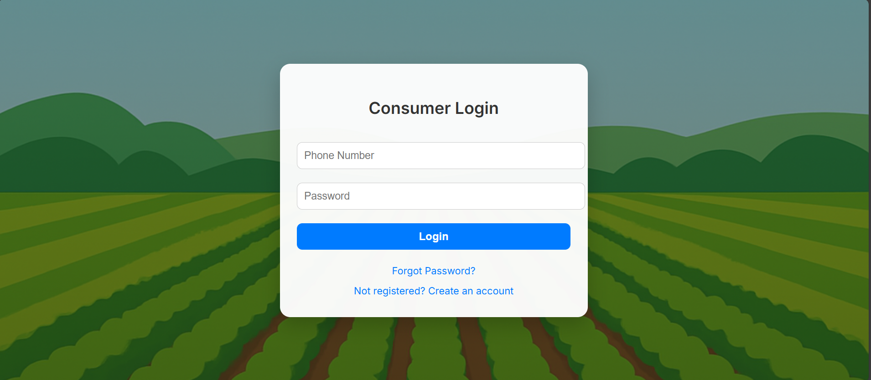
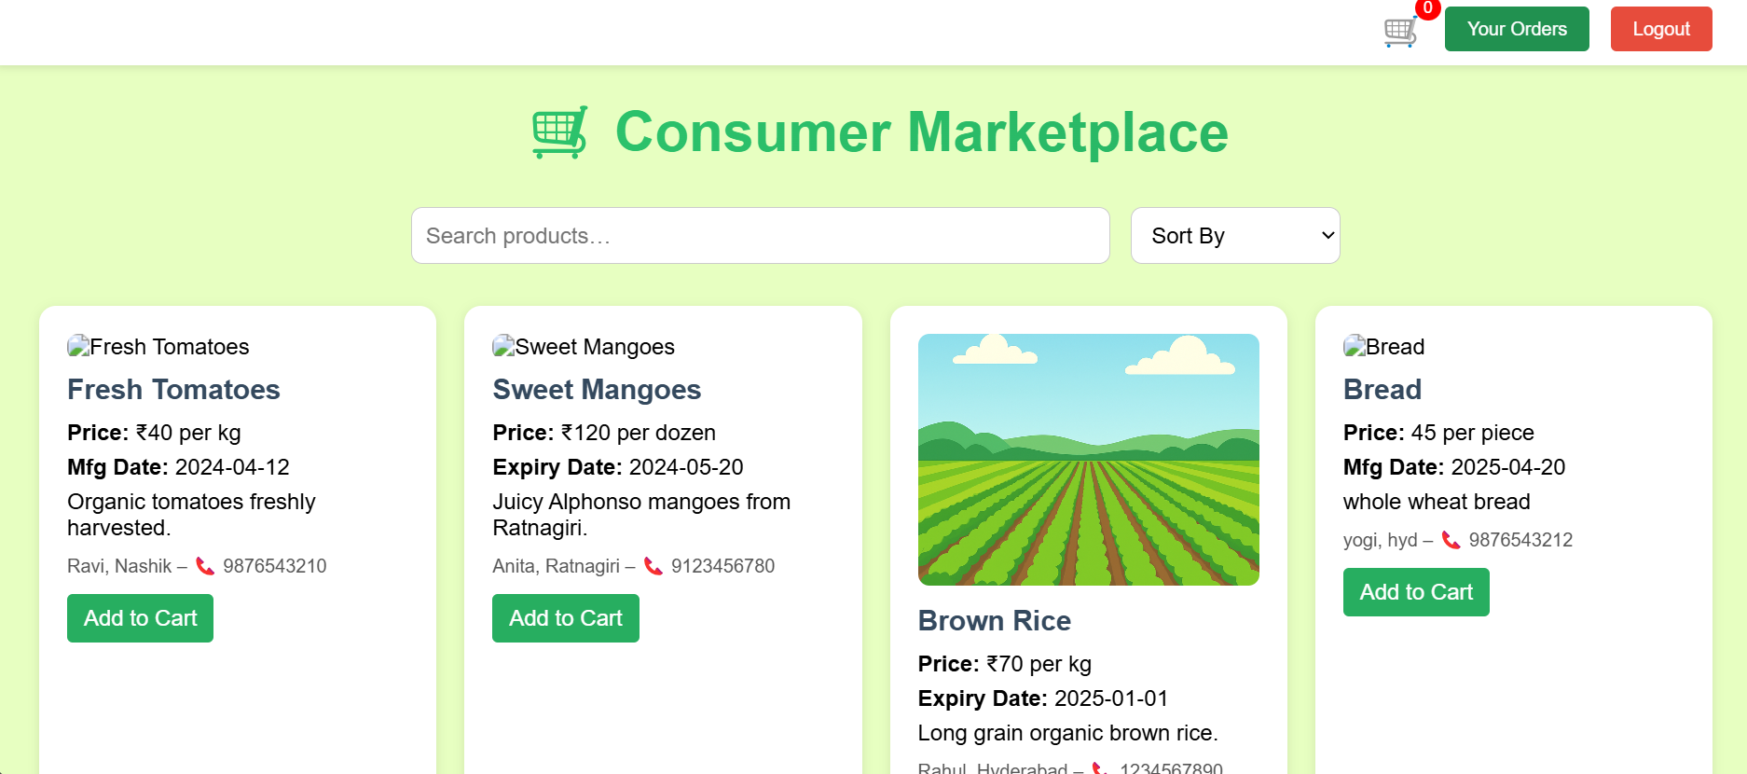
Consumer Module
• Consumer signup/login • Browse products

Slide 11
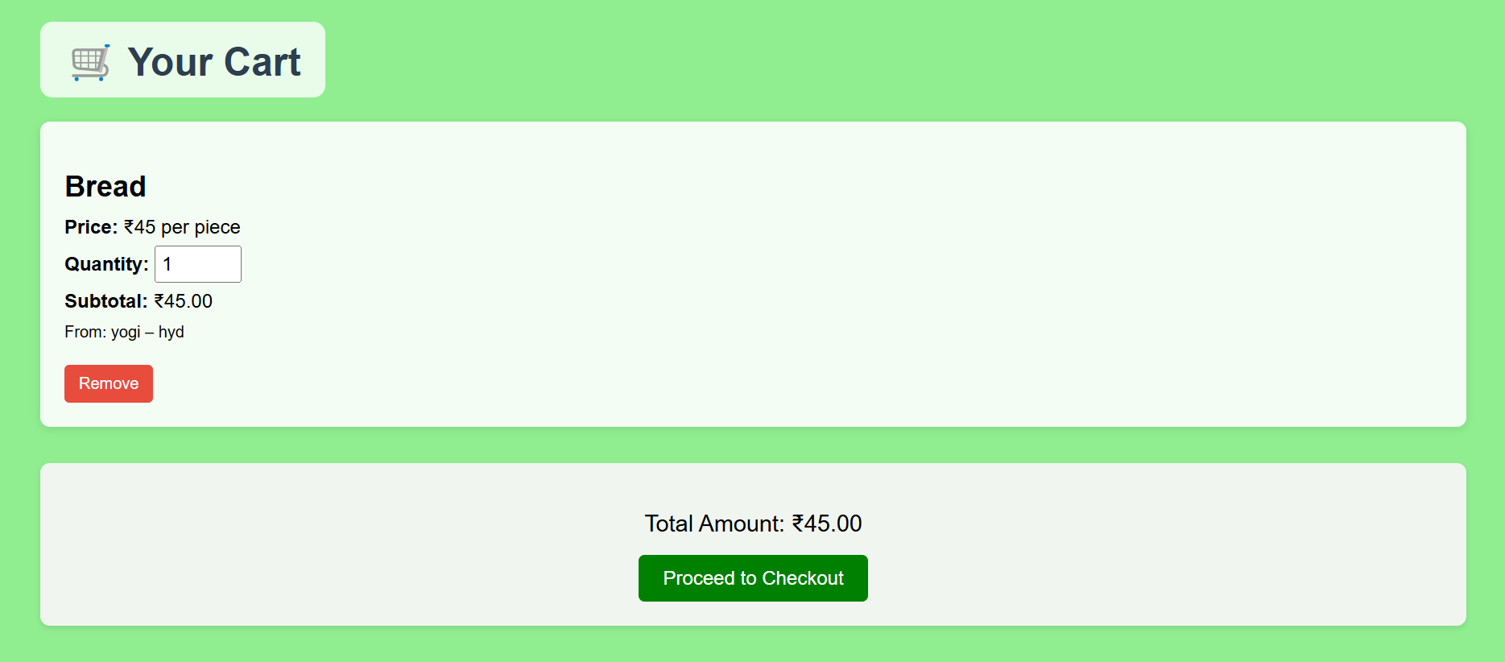
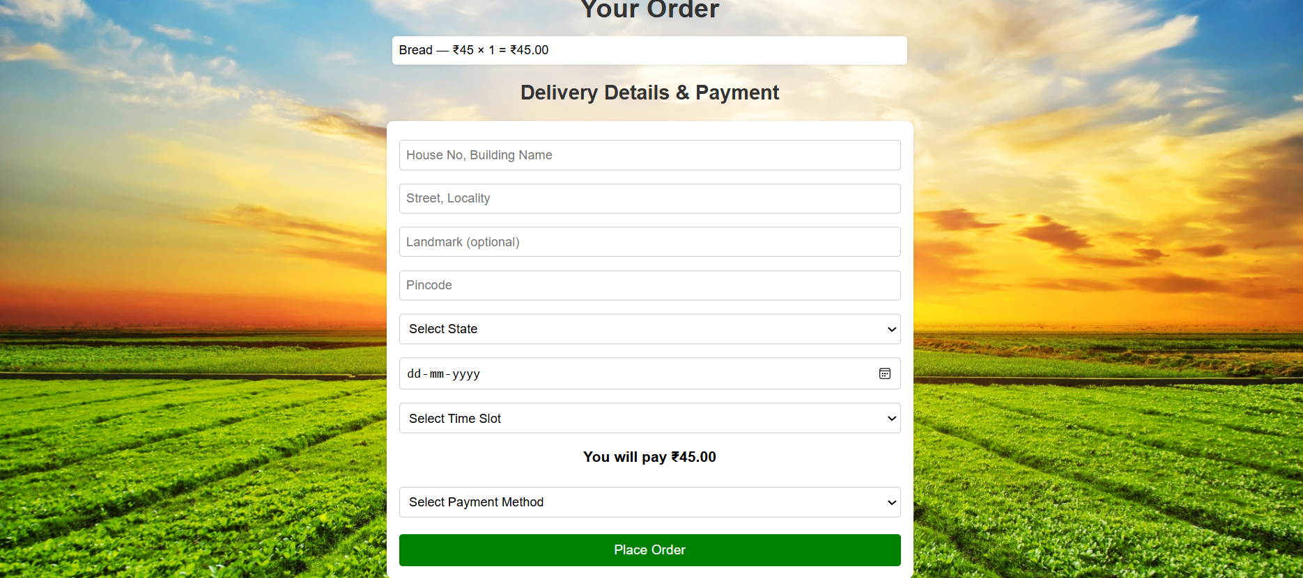
Consumer Module .Cart . Place order

Slide 12

Technologies Used
• Frontend: HTML, CSS, JavaScript • Backend: Node.js

Slide 13

Features Implemented
• Login Systems • Cart and Checkout • Payment Options • Order Tracking

Slide 14

Challenges Faced
• Frontend-backend sync • Cart updates • Database scaling

Slide 15

Future Enhancements
• Mobile App • GPS farmer suggestions • Dynamic pricing

Slide 16
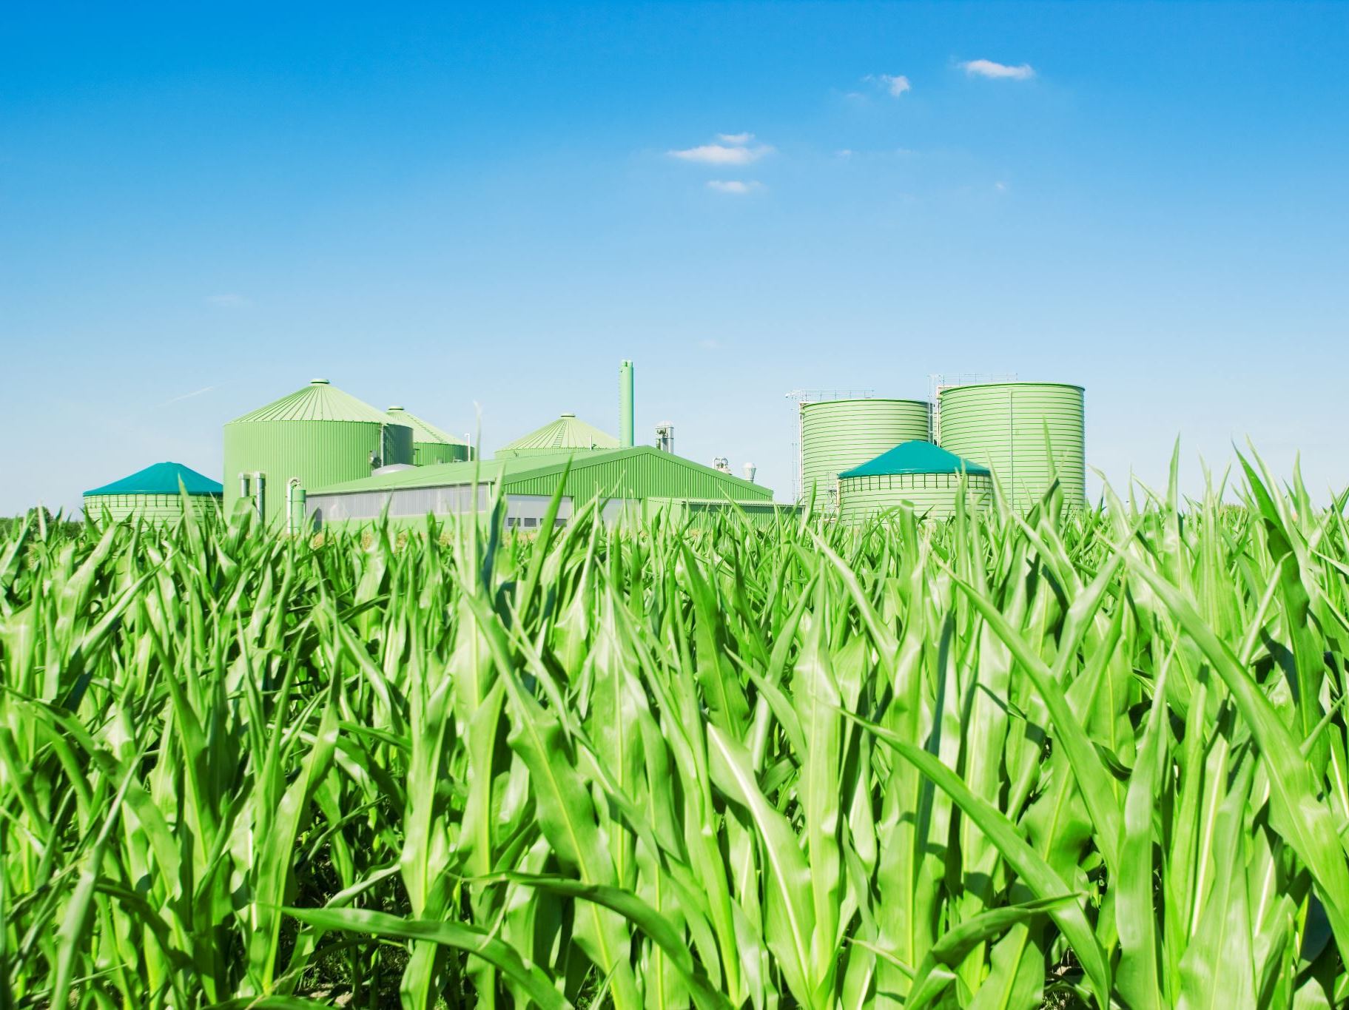
Conclusion
Platform empowers farmers and consumers, promoting fair trade and sustainability.

Slide 17

Thank You
Any Questions? 😊

